Slide 1
INTRODUCTION
Analysis and predicting the result of the international football matches that took place between 1872 to 2017.
The analysis involves calculating the home goals scored by teams in different tournaments and also calculating the likelihood of the dependency of home_score in different tournaments.
The result of a Bayesian analysis retains the uncertainty of the estimated parameters, which is very useful in decision analysis.

Slide 2
Dataset
The data contains description about the matches held in between 1872-2017.The description involves information like the date of the match, the home and away goal score of the team and the tournament in which the matches were held.
The column involved in the data are:
Date
Home_Team
Away_Team
Home_Score
Away_Score .
Tournament
City
Country

Slide 3
Basic Readings
A) Which team dominated the home conditions and scored maximum goals?
Australia in 2001 against American Samoa
Maximum home goals by a team?
31
Home_score greater than away_score?
18671
Correlation between home_score and away_score?
D) -0.131301(This shows that are opposites to each other means that when the teams score in home venue then they do not score that good on away venue.)

Slide 4
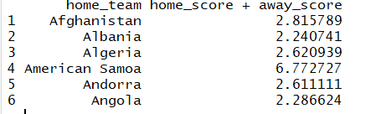
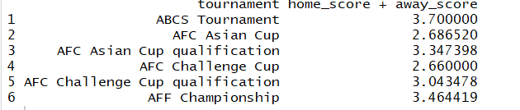

Slide 5
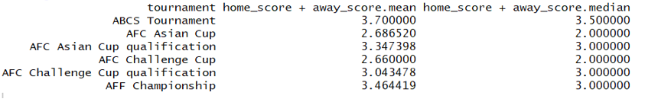
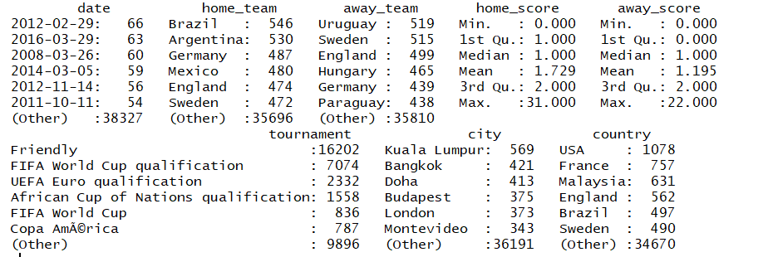

Slide 6
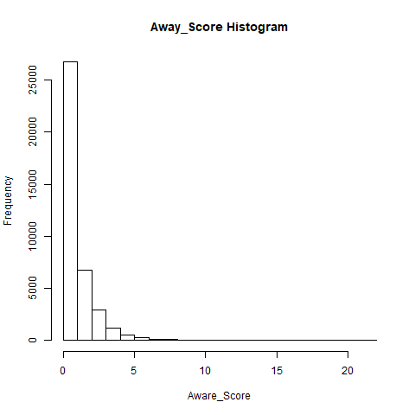
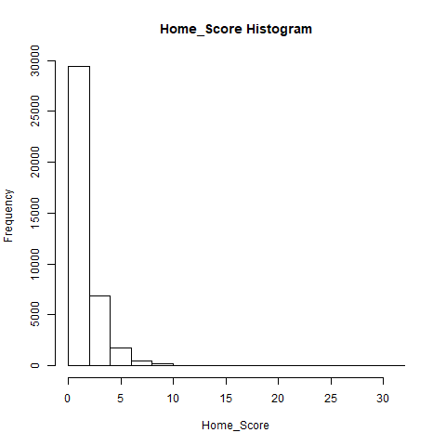

Slide 7
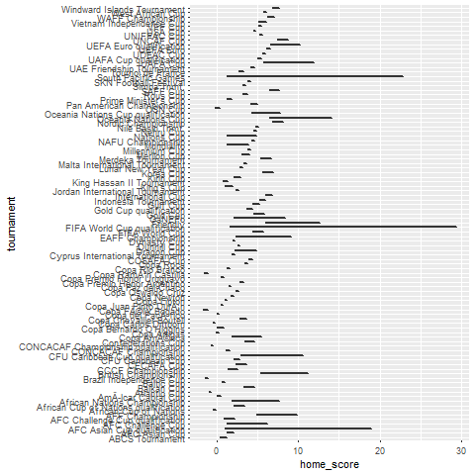

Slide 8
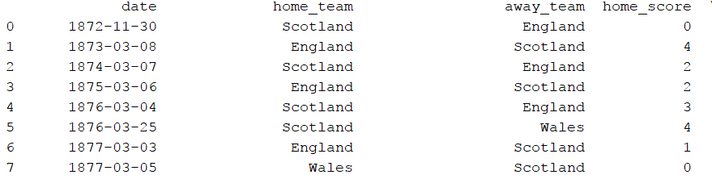
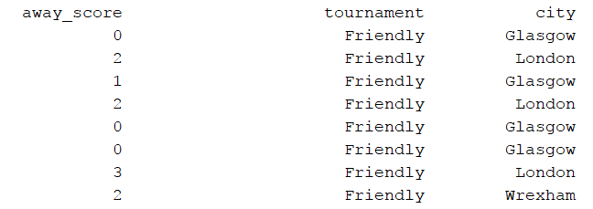

Slide 9
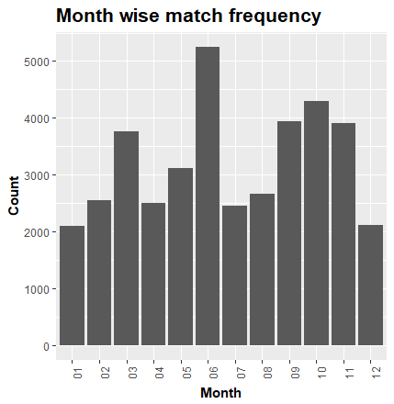
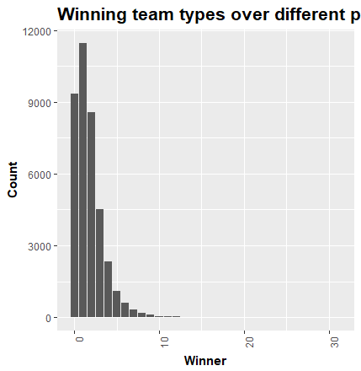

Slide 10
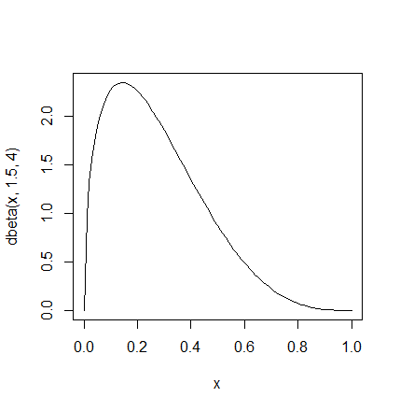
Problem Statement: To find the likelihood of the teams scoring home goals in different tournaments than away goals.
Step 1-
Specifying the Prior for a proportion
For this I took the three quantile as 50%,99,99%,0.001%
Using LearnBayes package in R we will get the prior proportion and then plot the prior density graph.

Slide 11
Step 2-
Calculating the Likelihood Function
Step 3-
Calculating the Posterior Distribution

Slide 13
